Slide 1
Effect of Lightning and Precipitation on Global Electric Circuit
Yifei Fang
April 24, 2019
Advisor: Professor Jeremy Thomas Professor Natalia Solorzano

Slide 2
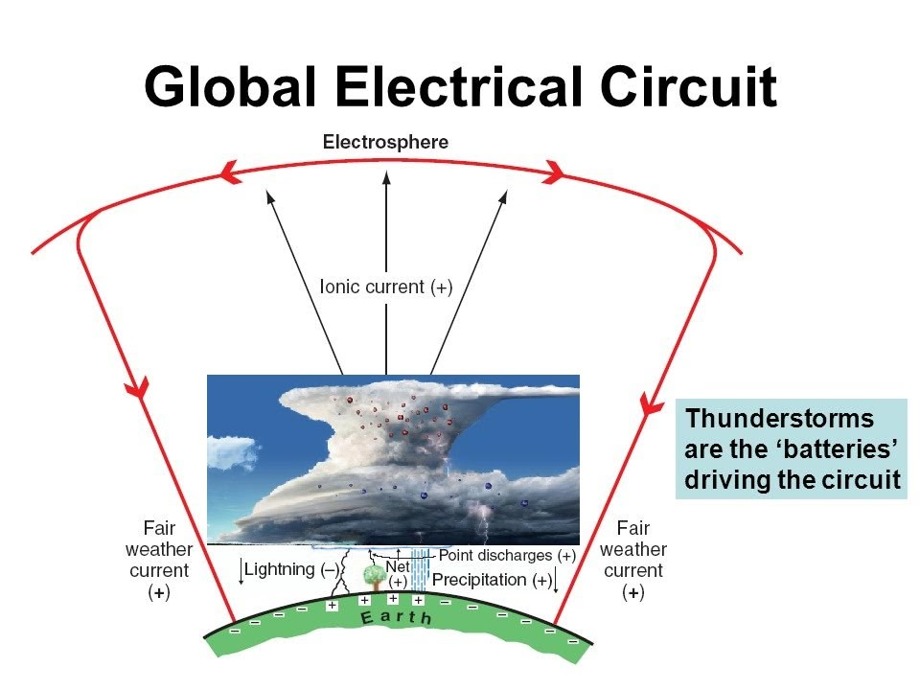
Global Electric Circuit
Motivation & Use Model
Find out what is driving the Global Electric Circuit
Measurements of fair weather electric field + current density for several day
The major use model is to test the hypothesis that thunderstorm is the primary driver for global circuit [1]
Notes:
1. Introduction
The global electrical circuit can be thought of as a leaky sphericalcapacitor,wheretheearth'ssurfaceisthenegatively chargedinnershellandtheearth'sionosphereisthepositively chargedouterlayer.Sincetheatmosphericconductivityislow, butnon-zero(about1014(Ωm)−1),neartheearth'ssurfaceand increases exponentially with height, most of the positive chargeintheatmosphereresidesnearthesurface(90%within 5 km). The global circuit maintains a potential of 150–600 kV (mean of about 280 kV) between the earth and the bottom of theDregionionosphereat60–90kmaltitude,whichresultsin afairweatherverticalelectricﬁeldofabout−100V/mnearthe earth's surface (Roble and Tzur, 1986) (note that here and throughout this analysis a positive electric ﬁeld indicates the direction of motion of a positive test charge). Since these fair weather charges remain quasi-stable over time, a driving mechanism must exist that supports this charge distribution
andtheresultingfairweatherelectric ﬁeld.Withoutadriving mechanism, the earth-ionosphere capacitor would discharge in less than 1 h (Roble and Tzur,1986).

Slide 3
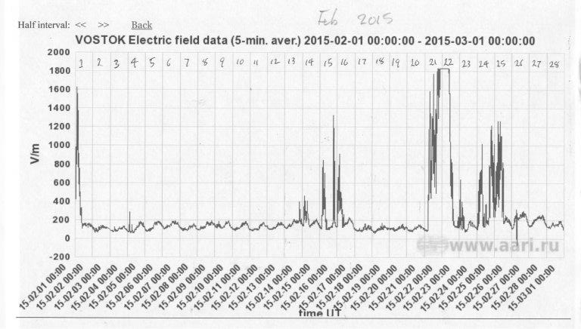
Back Ground Info
[1]
Notes:
Mention the 5 day

Slide 4
Back Ground Info
Global Electric Circuit Balloon Project
30km+ altitude
Clean measurement of high time resolution current density

Slide 5
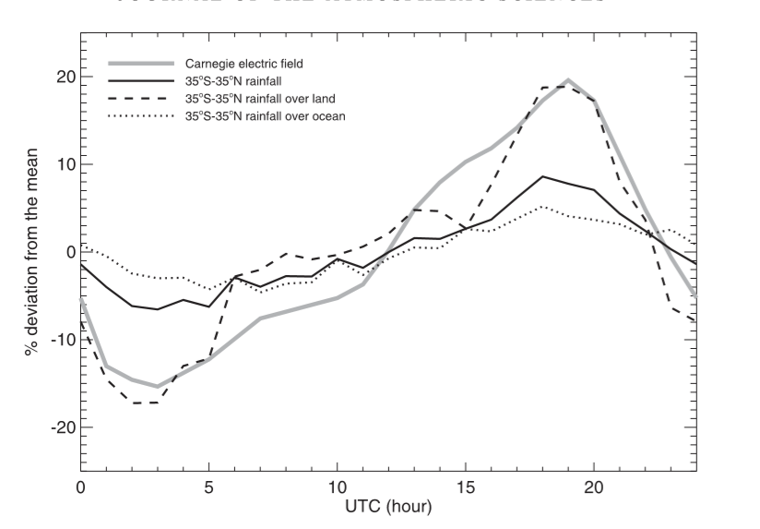
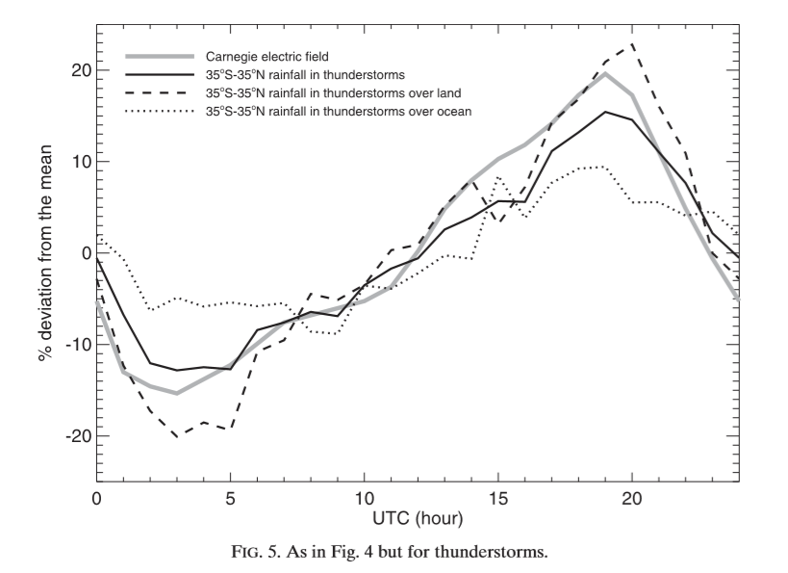



Similar Work
[1]
[1]
Notes:
Electric field comes first after ut 12

Slide 6
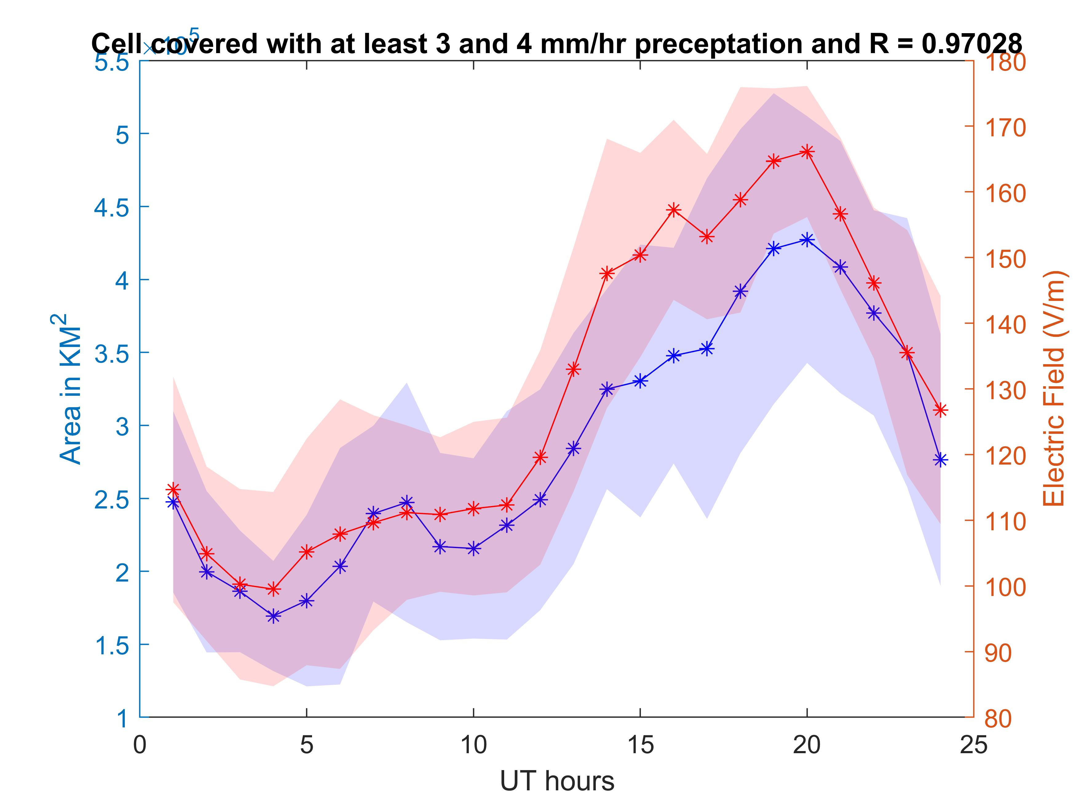
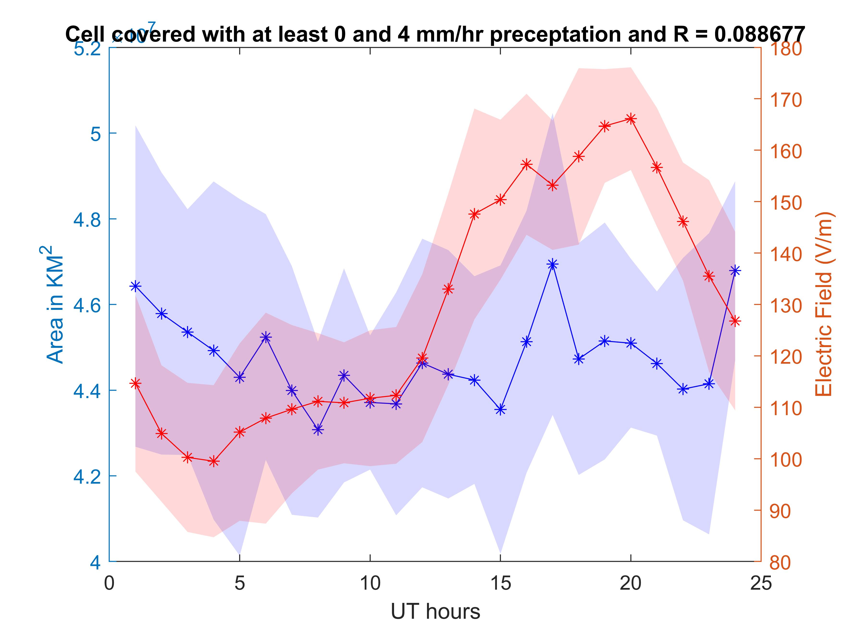
Our Plots

Slide 7
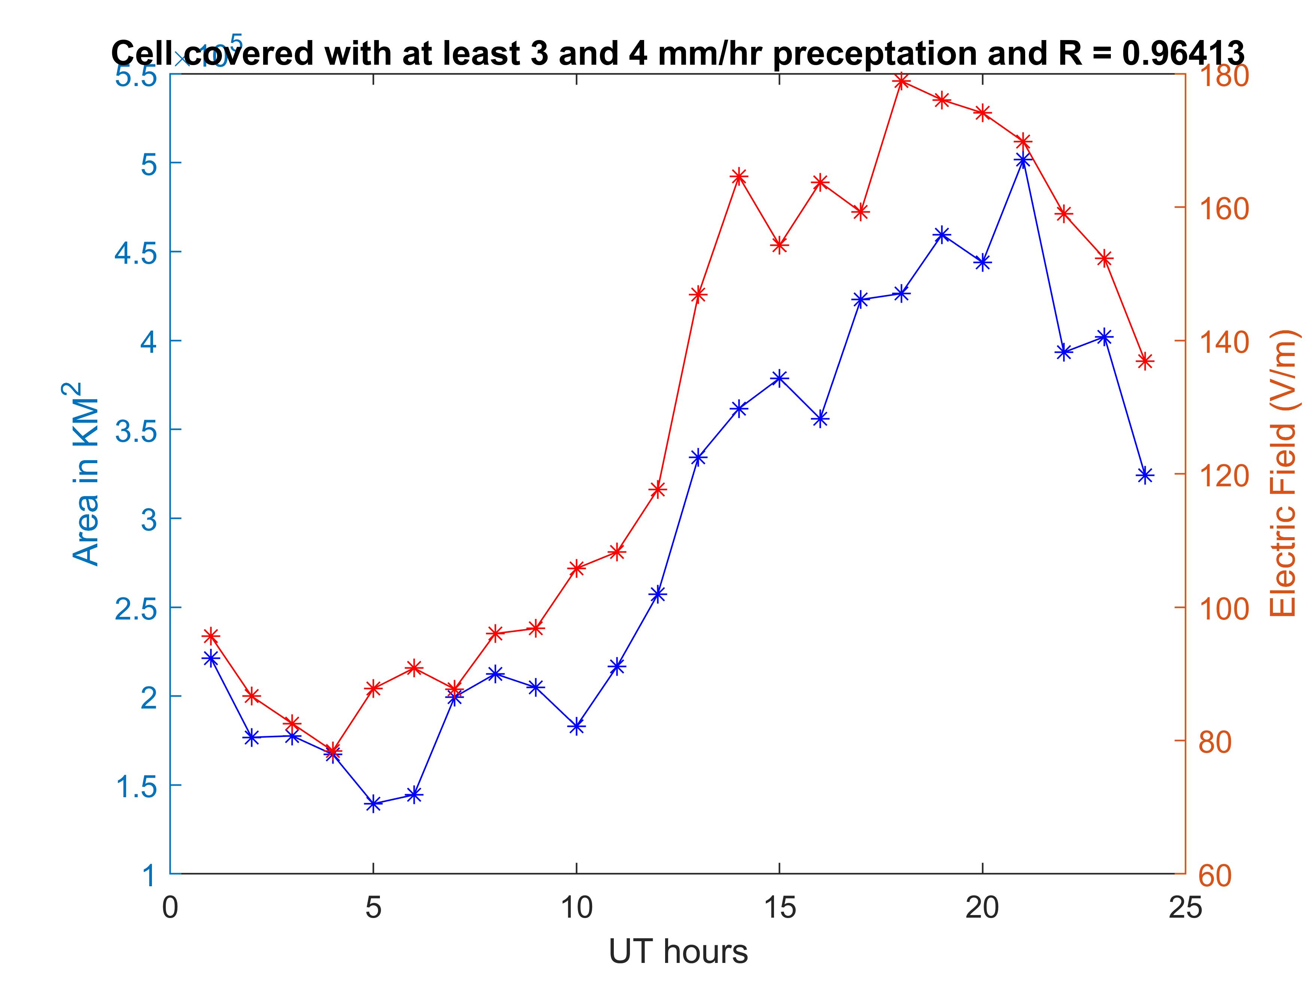
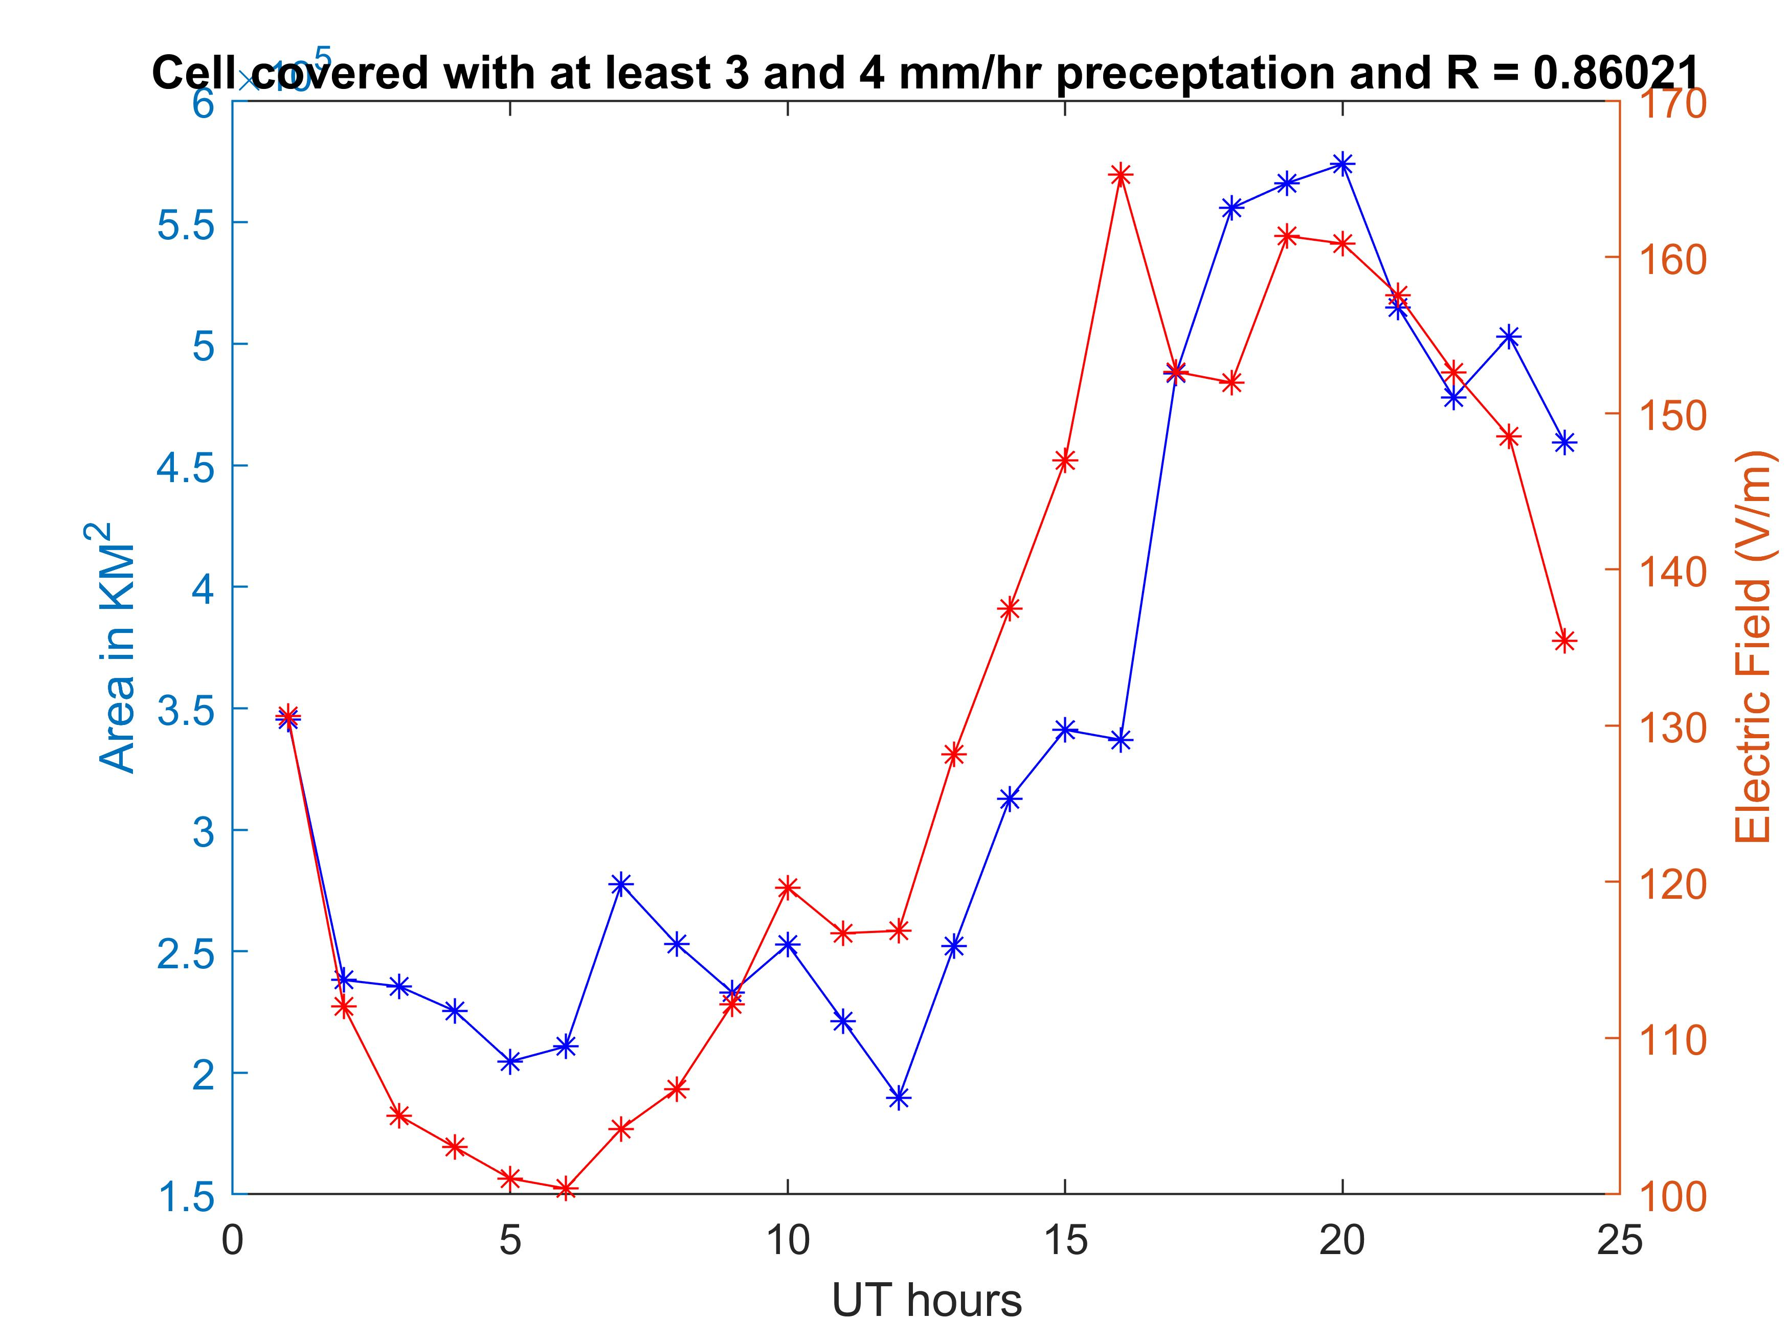
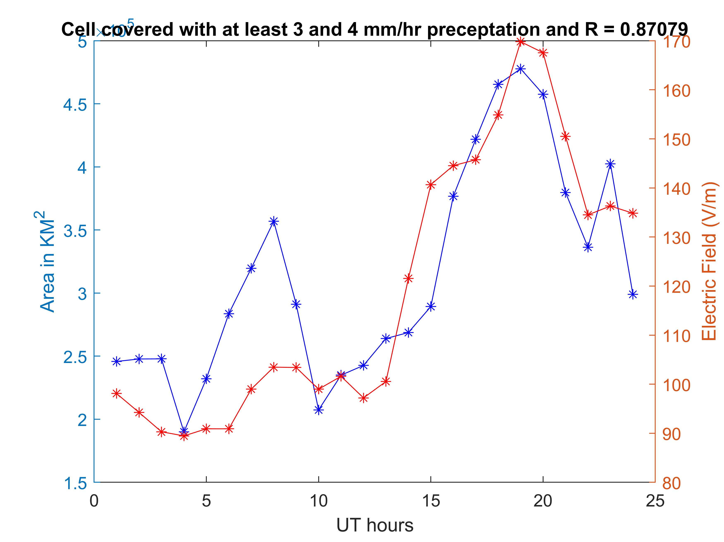
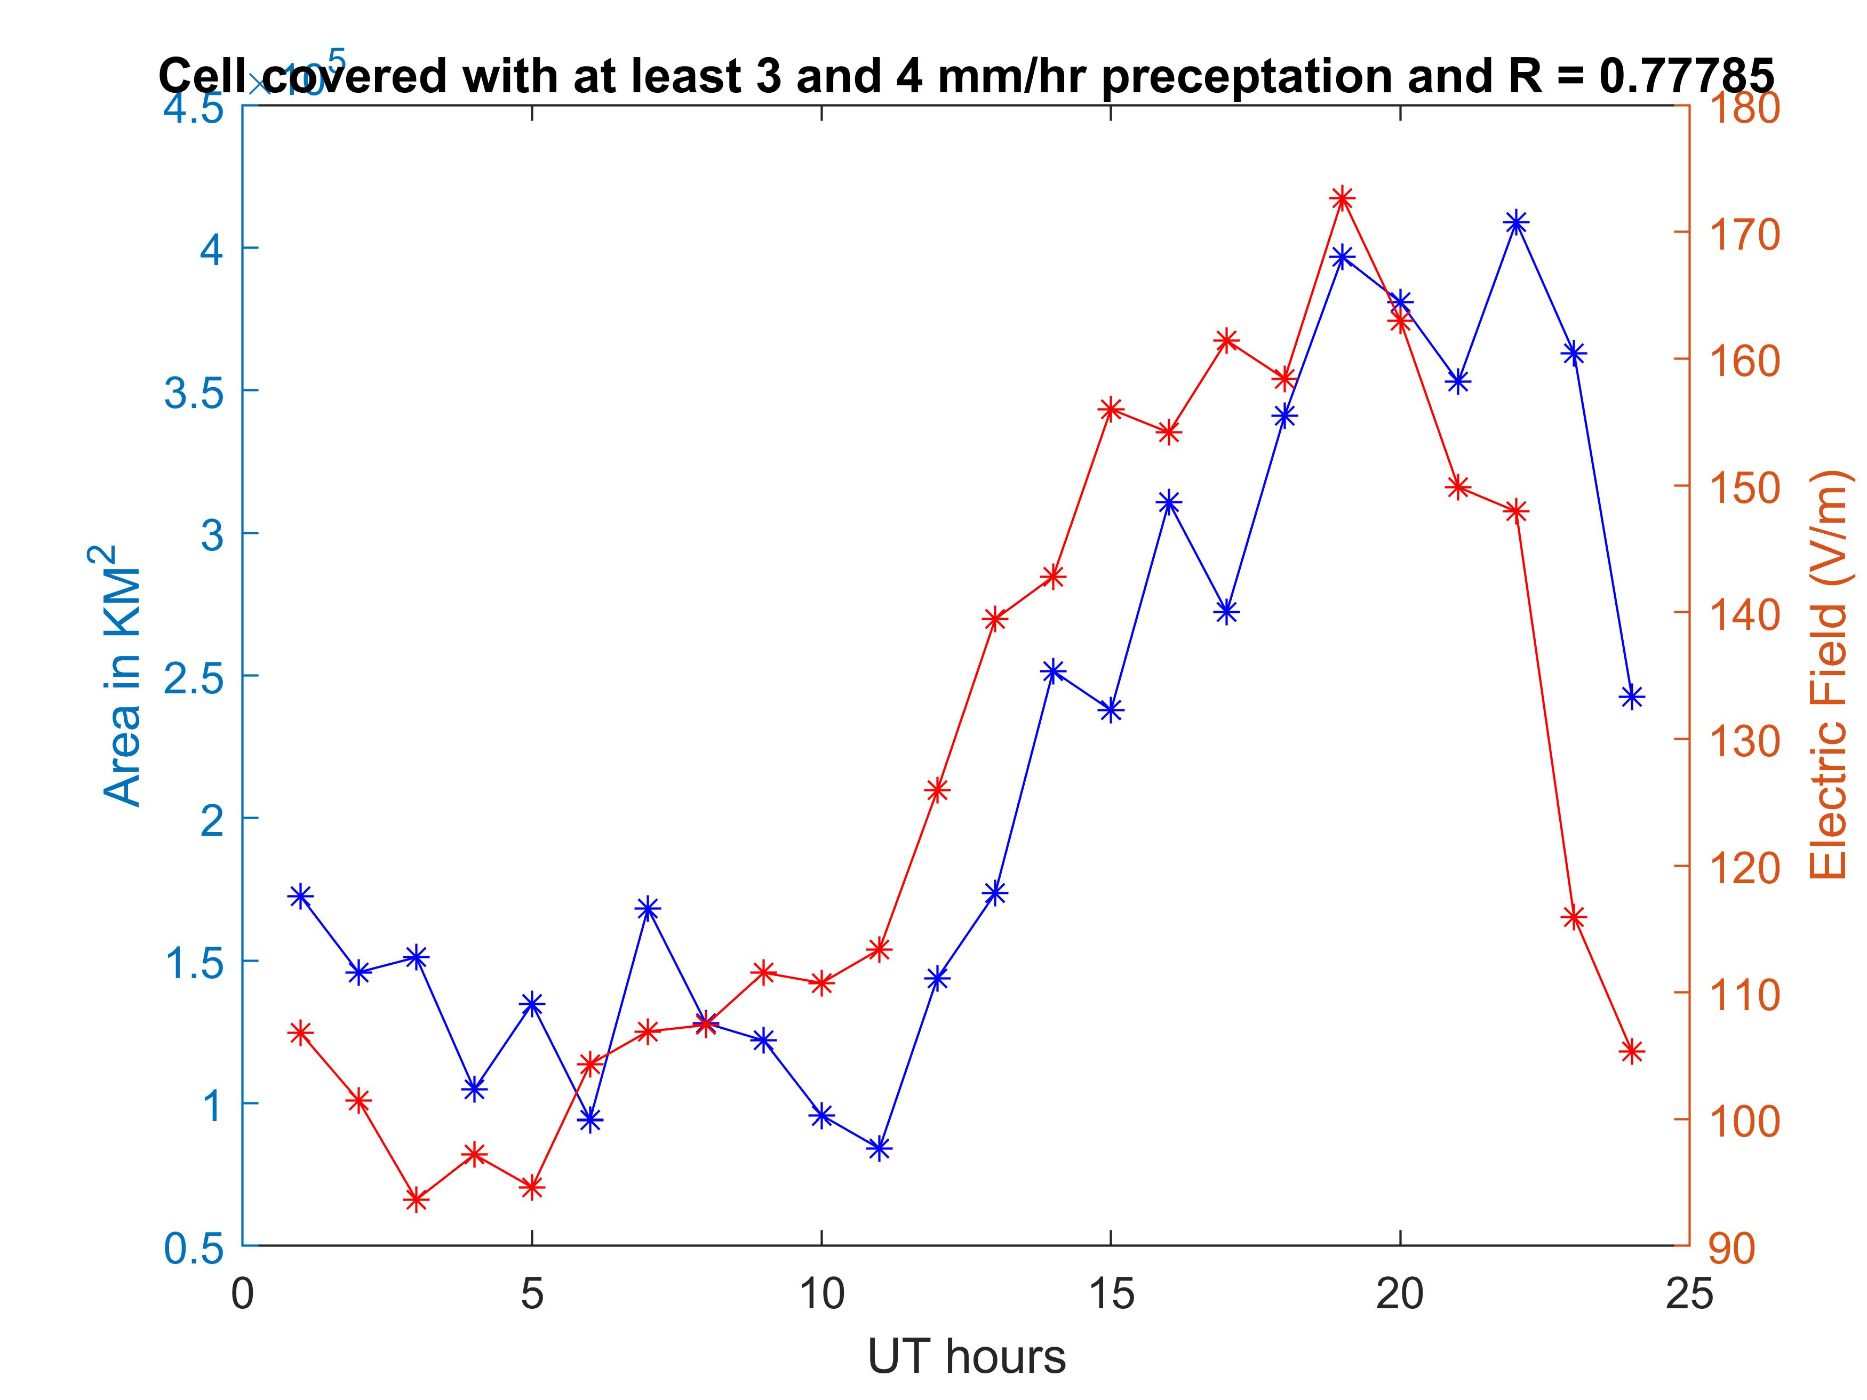
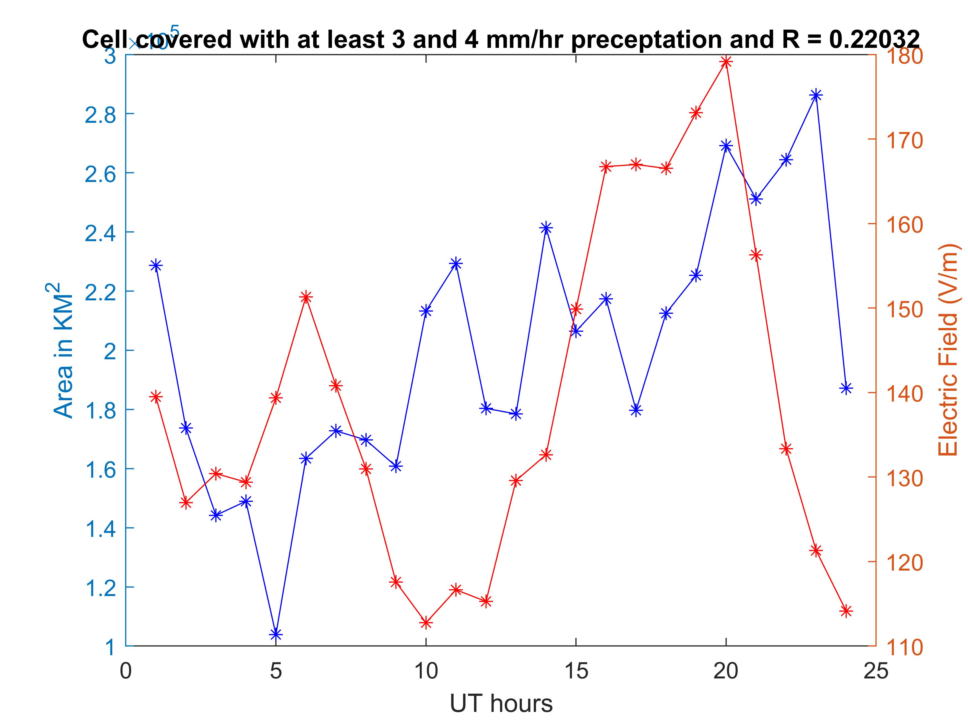
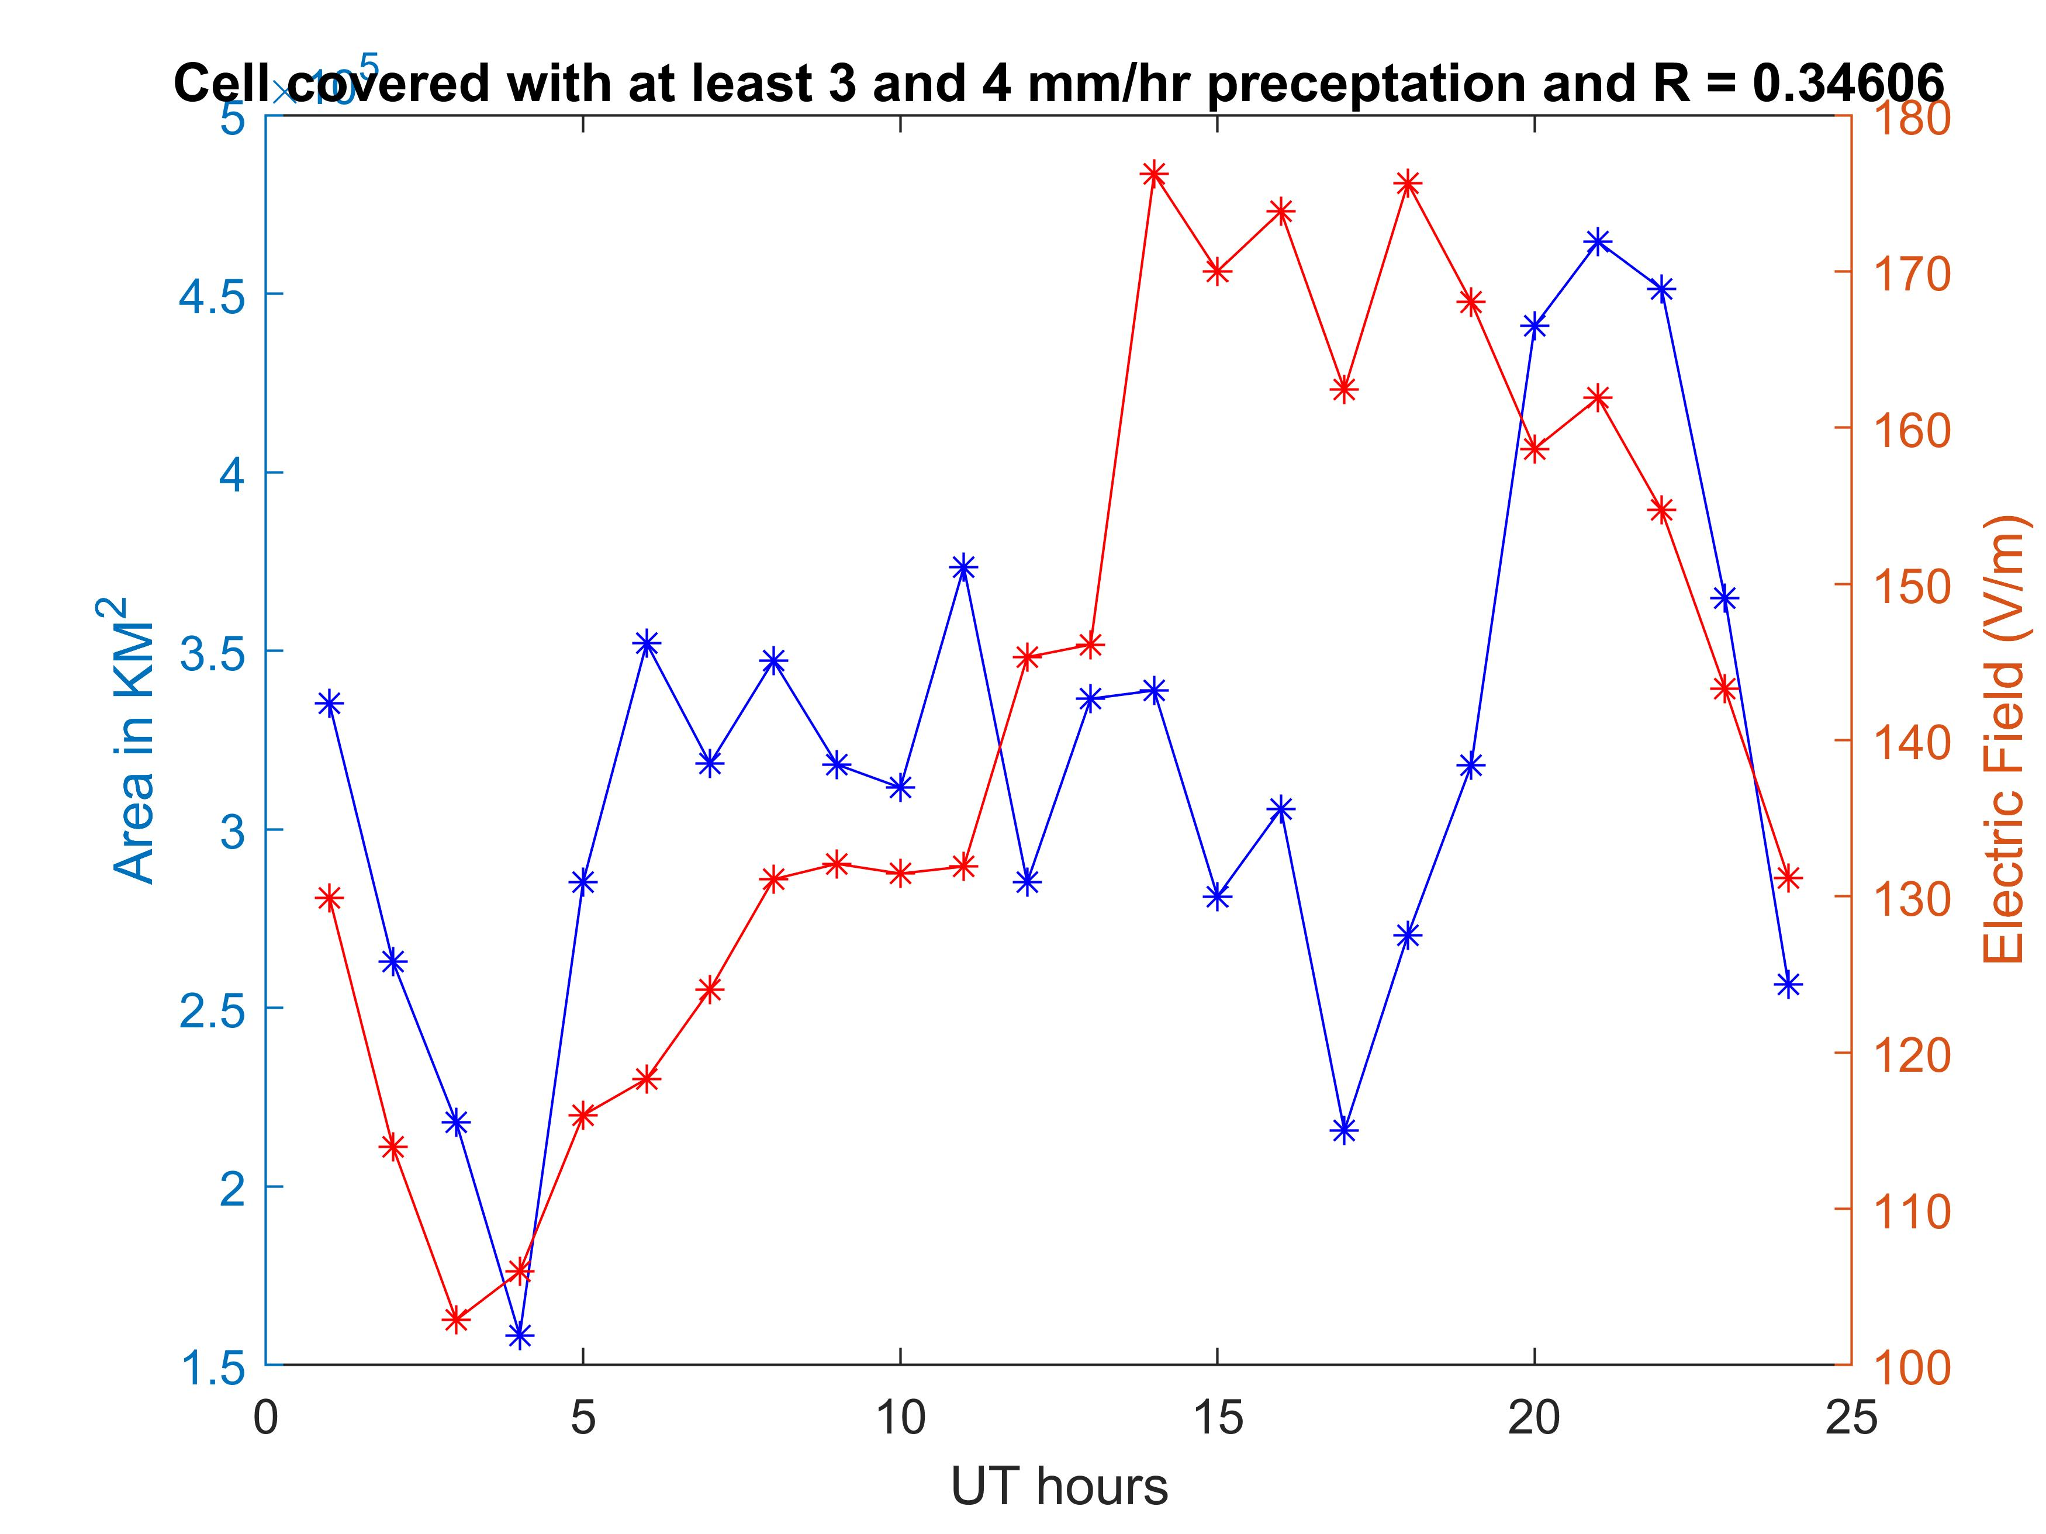
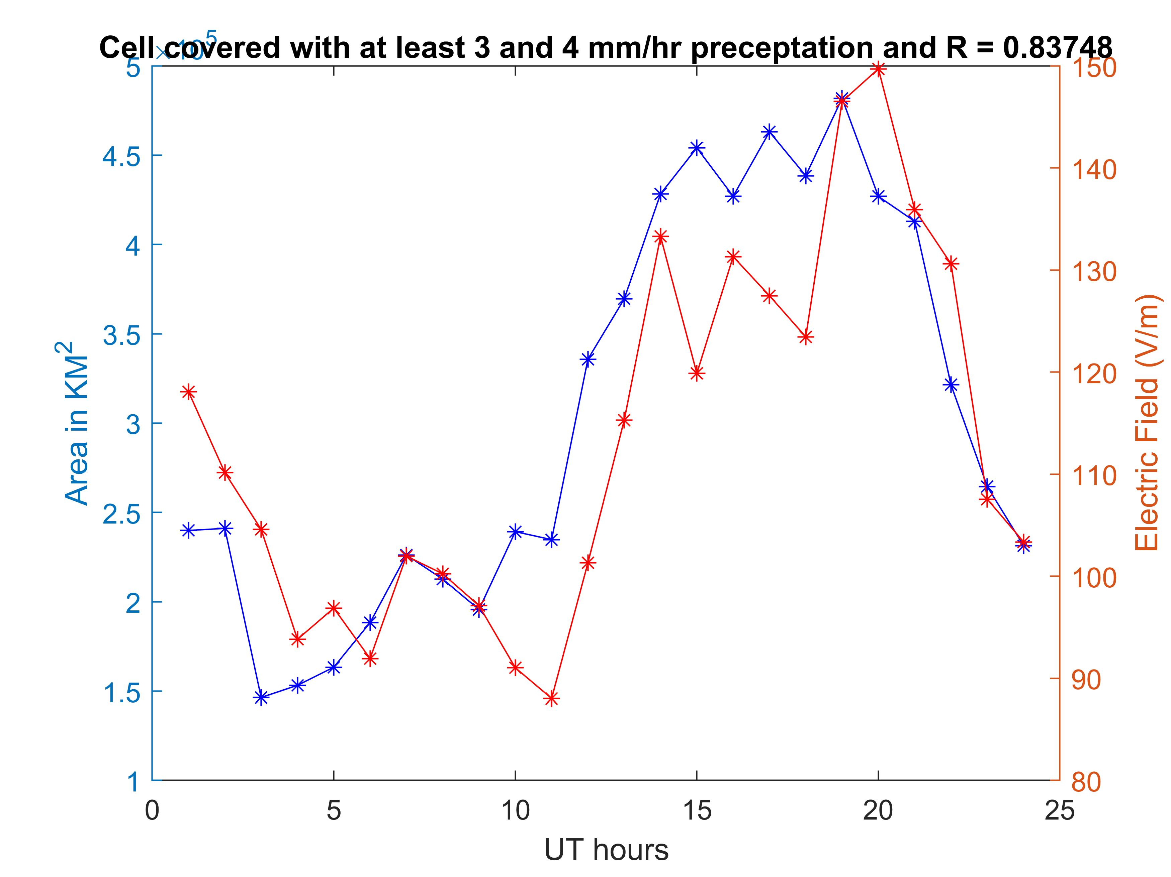
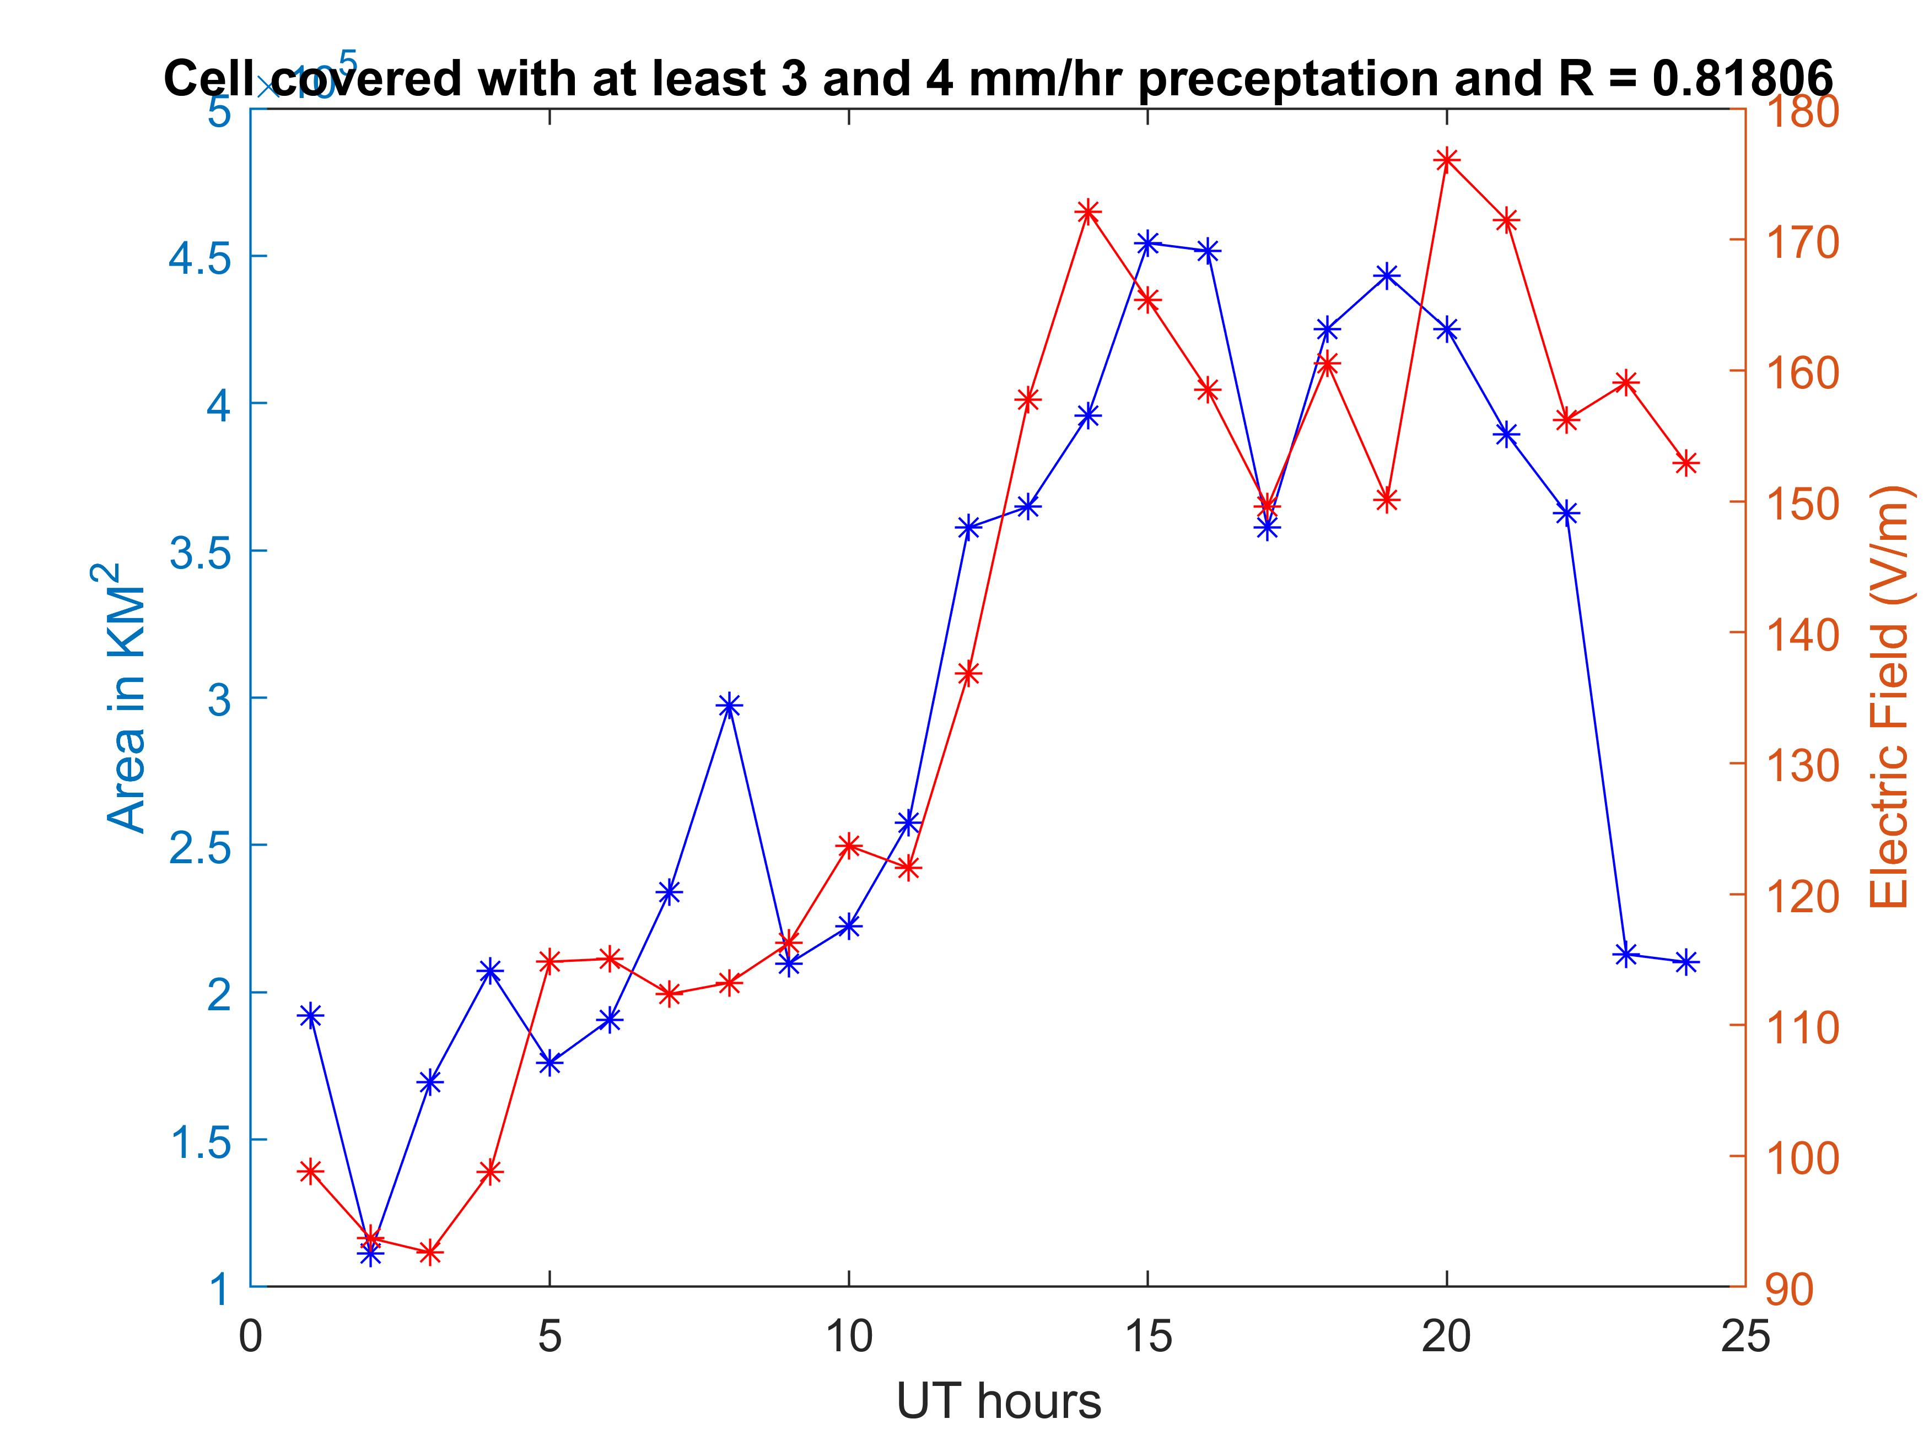
Our Plots

Slide 8
How we achieved it
Regrid IMERG and WWLLN dataset to a 360 * 720 (0.5° * 0.5°) cell
Correct area for WWLLN lightning counts
Save IMERG, WWLLN and VOSTOK dataset to a 4D double for different generate script to use
Generate different combination and make the plots

Slide 9
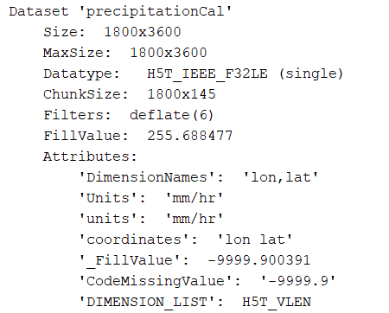
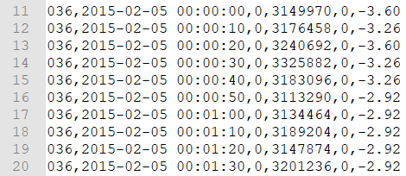
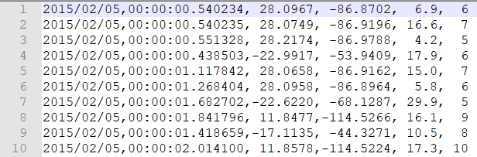
Raw Data Set
IMERG (HDF5)
WWLLN (CSV)
VOSTOK (CSV)

Slide 10
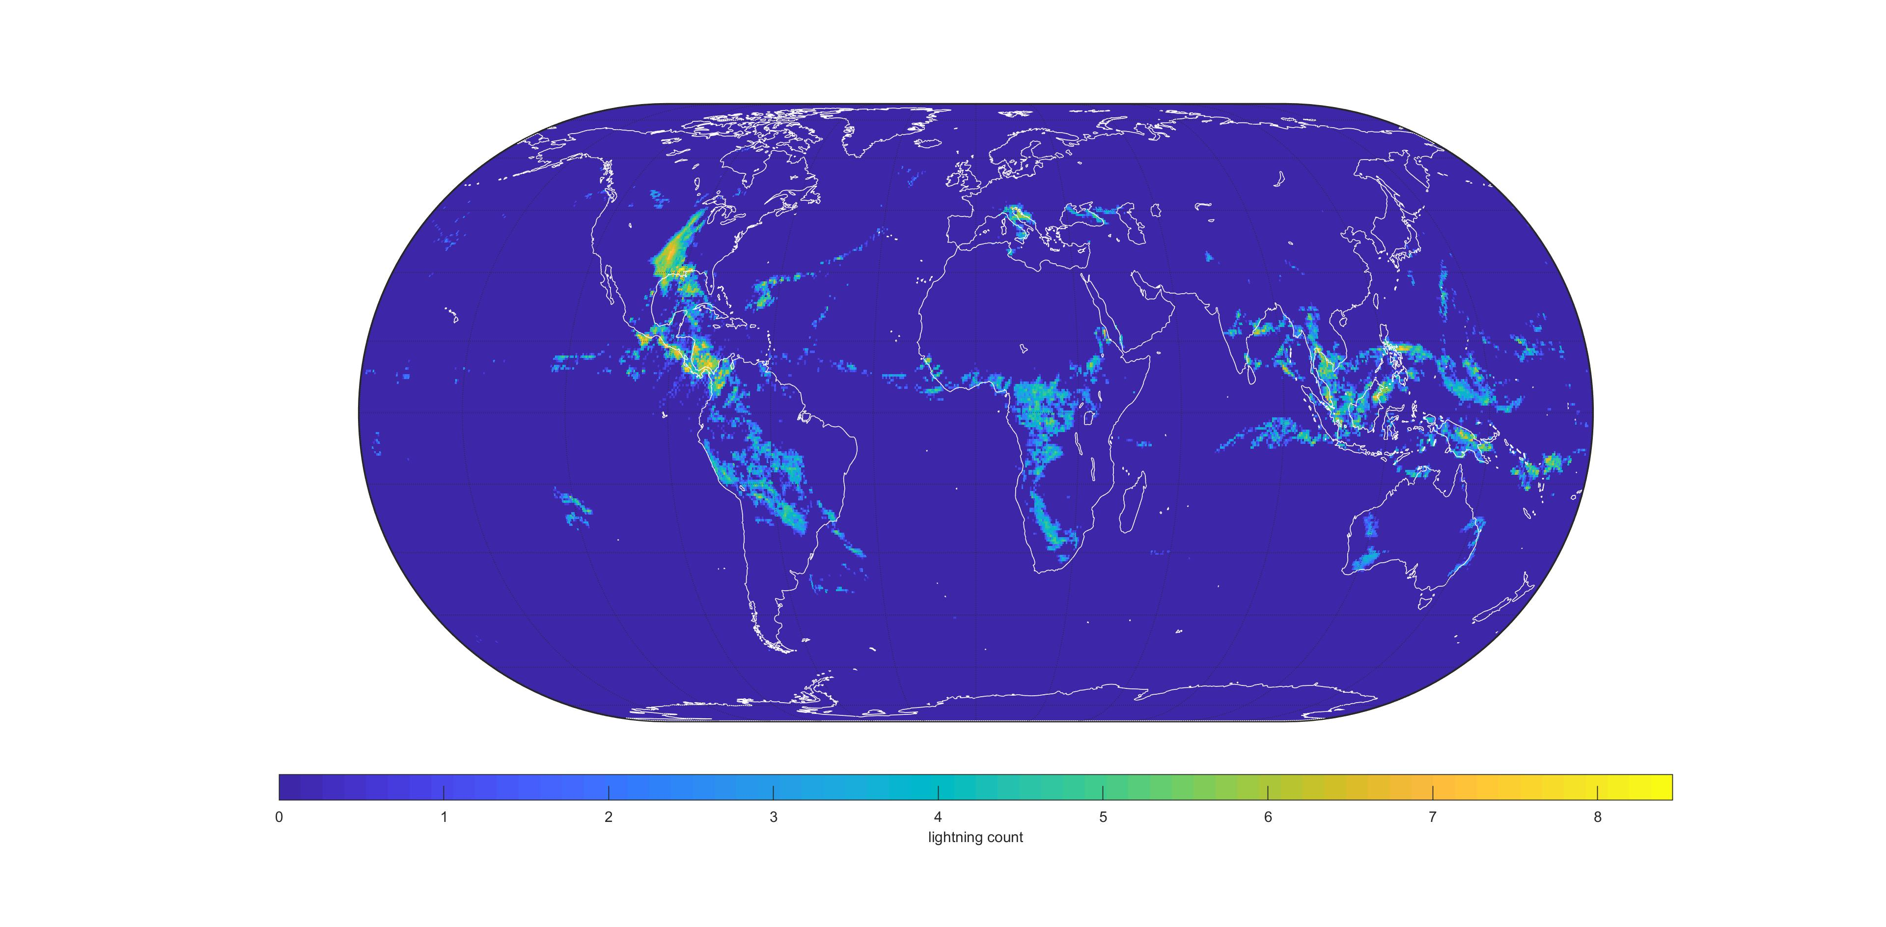
Gridded Data

Slide 11
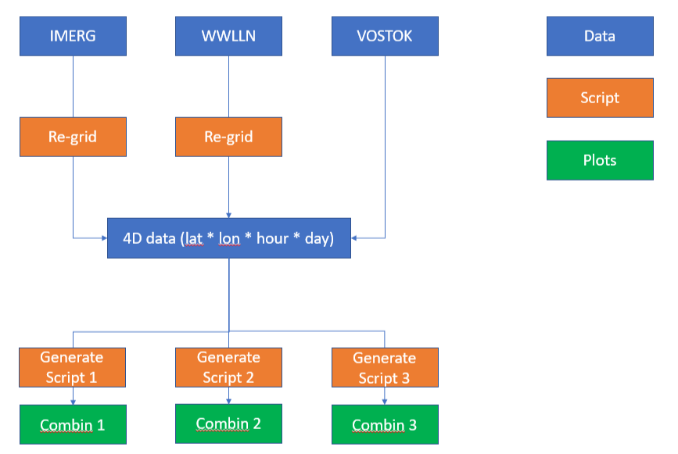
Software Structure

Slide 12
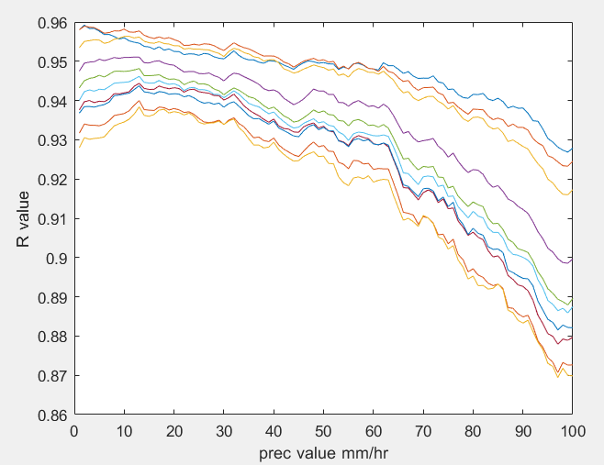
Conclusion

Slide 13
Reference
https://journals.ametsoc.org/doi/pdf/10.1175/2009JAS3248.1
https://webmail.digipen.edu/roundcube/?_task=mail&_action=get&_mbox=INBOX&_uid=6023&_part=2&_frame=1&_extwin=1
https://webmail.digipen.edu/roundcube/?_task=mail&_action=get&_mbox=INBOX&_uid=6532&_part=2&_frame=1&_extwin=1

